Slide 1

SEcube Utilities
A.A 2020/2021
Cybersecurity for Embedded Systems
A GUI for the SEcube device and its open source SDK
Referents: Prof. Paolo Ernesto Prinetto, Matteo Fornero, Nicolò Maunero, Gianluca Roascio
Students: Gaetano Galasso, Andrea Pignata, Andrea Russo

Slide 2
Outline
Introduction
Tour of the GUI
Implementation
Conclusions

Slide 3
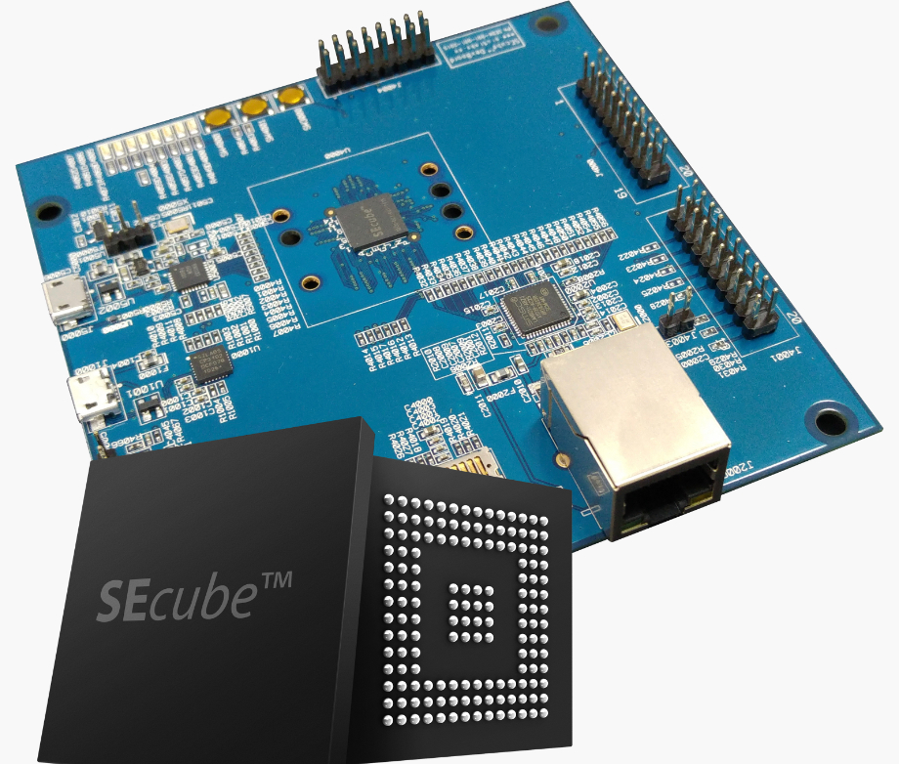
The SEcube
Three main cores in a single chip
Can be defined as a Security Environment
Can be used as security coprocessor for encryption, decryption and digest computation
Advantages of a separate device for key storage and crypto functions: faster and more secure
An Open Source SDK is available

Slide 4
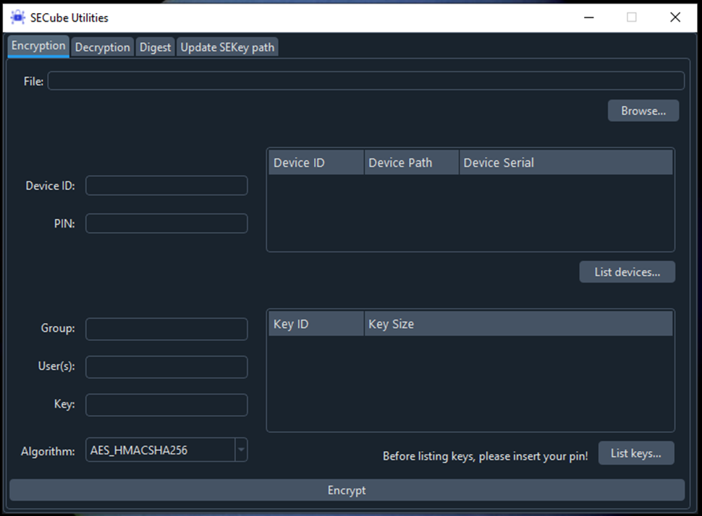
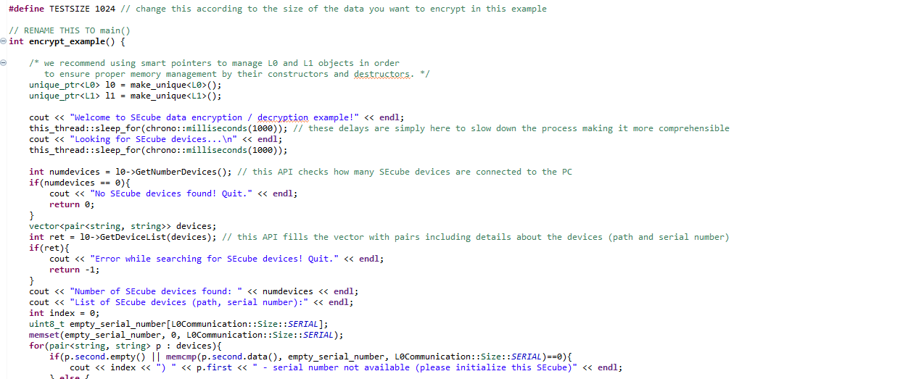

Why SEcube Utilities?
From this…
…to this
🤯
😌

Slide 5
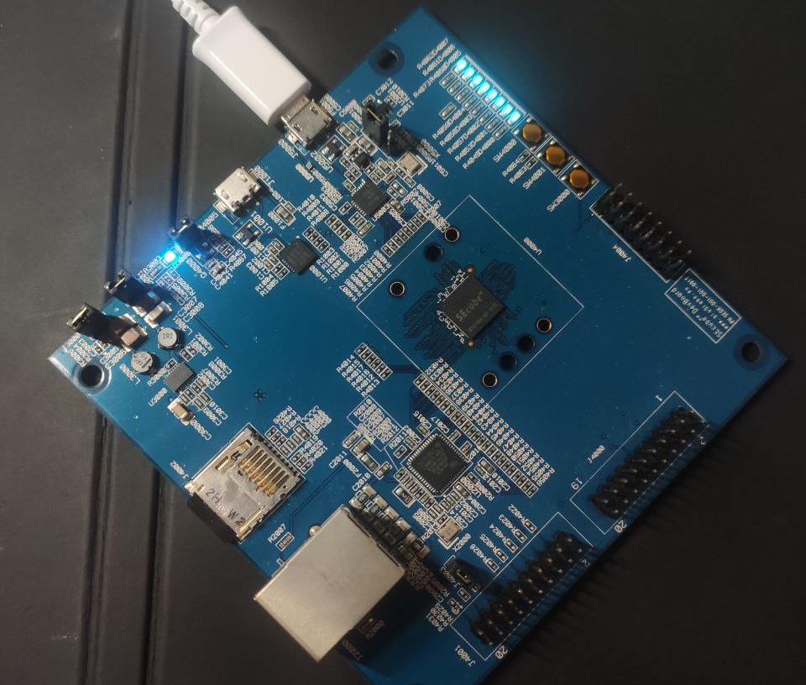
Goals
No more need to write and compile code for each operation…
… but a simple GUI interface
Targeted at the final user
Support for encryption/decryption and digest computation
Compatibility with manual key management, SEkey and SEfile
Compatibility with Linux and Windows
SEcube Utilities - Gaetano Galasso, Andrea Pignata, Andrea Russo

Slide 6
Outline
Introduction
Tour of the GUI
Implementation
Conclusions

Slide 7
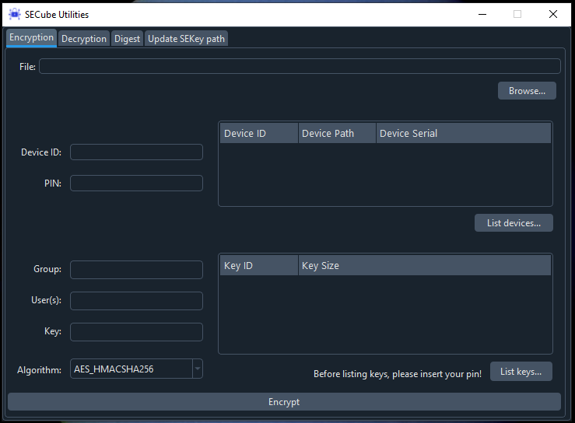
Let’s take a look!
4 main functions
List of connected SEcube devices
Support for SEkey KMS (group or users)
List of keys
(in case of manual management)

Slide 8
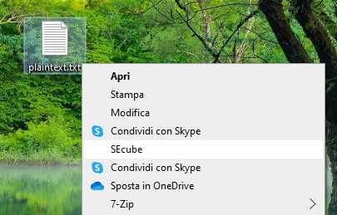
A little advantage for Windows users
…The GUI will launch with the correct file already chosen.

Slide 9
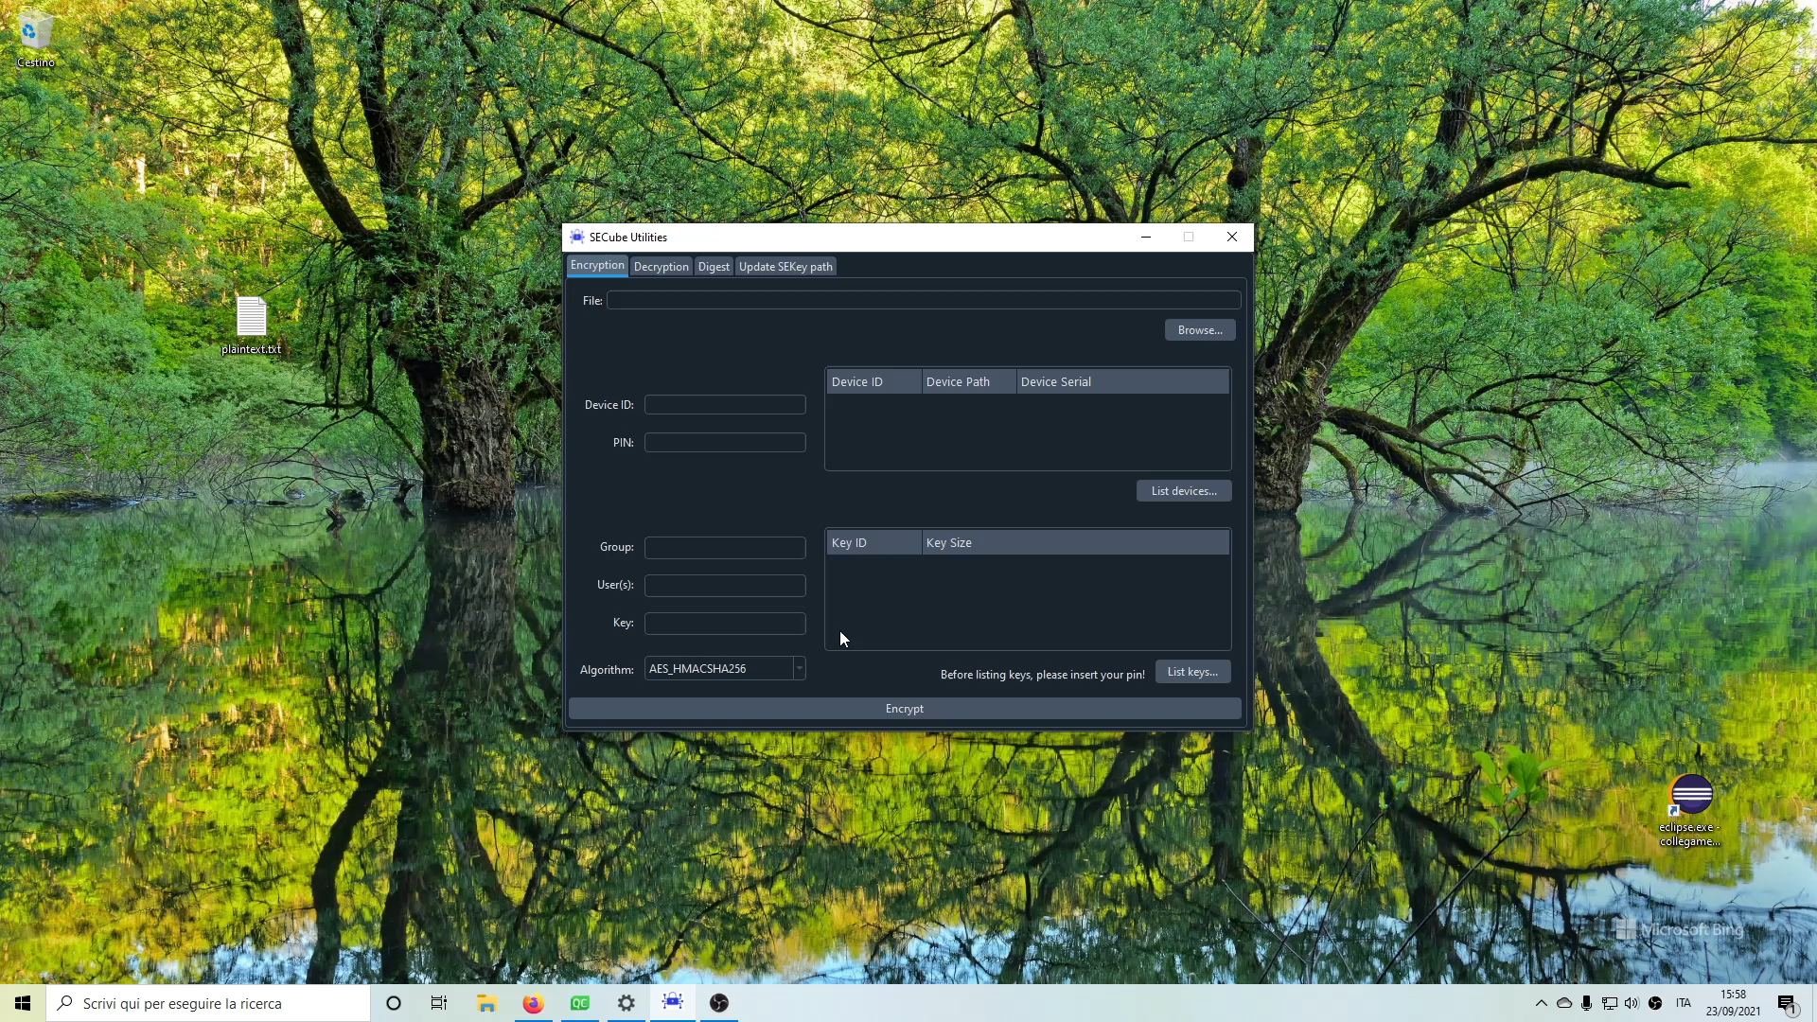
Video demonstration

Slide 10
Outline
Introduction
Tour of the GUI
Implementation
Conclusions

Slide 11


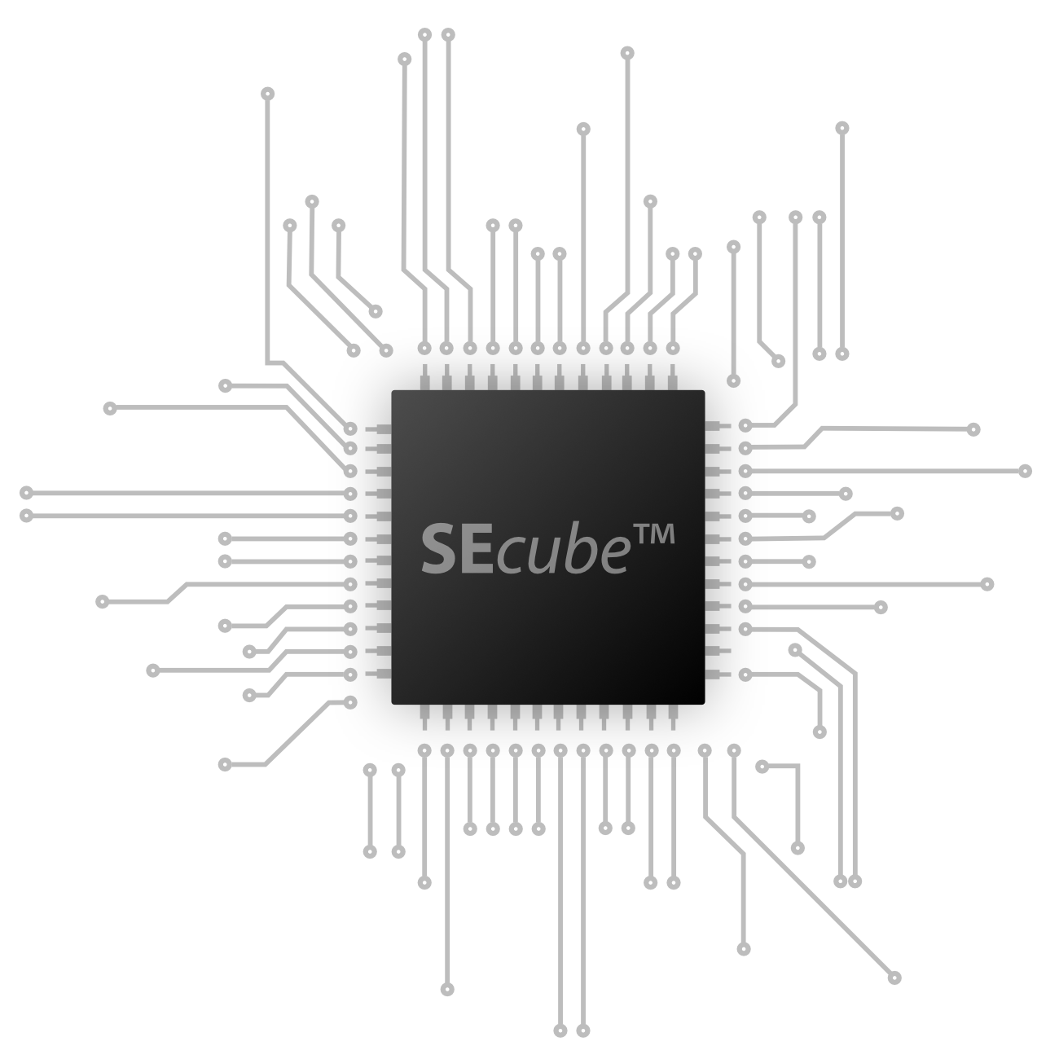
Steps of Implementation
SEcube Utilities GUI
SEcube Utilities Backend
SEcube Open Source SDK
SEcube Device

Slide 12
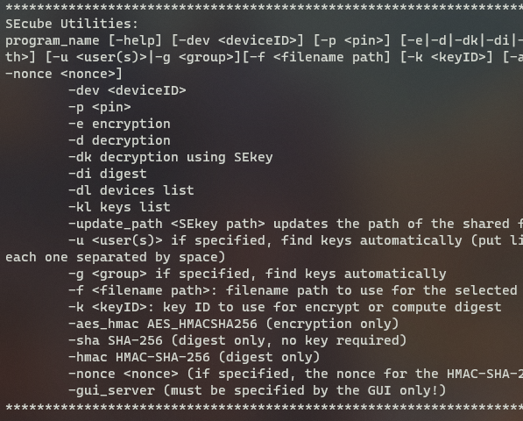
Backend
A byproduct
Fully featured command-line interface, useful for remote servers or under-mainteinance devices
Encryption, Decryption, Digest and some other general utilities
Complete guide can be called with the –help argument
Windows and Linux compatible

Slide 13





Steps of Implementation
SEcube Utilities GUI
Inter-process sockets
SEcube Utilities Backend
RESPONSE
REQUEST
SEcube Open Source SDK
SEcube Device

Slide 14
Outline
Introduction
Tour of the GUI
Implementation
Conclusions

Slide 15
Conclusions and Comments
Issue: Decryption utility is not working on Linux due to a problem with the secure_ls() function in the SDK.
Future Development: Secure Explorer, a utility to show all the encrypted files in a folder with their decrypted name.
Future Development: Deeper integration with SEkey, to show all the available groups/users.

Slide 16
Conclusions and Comments
In conclusion, SEcube Utilities is an easy-to-use program to encrypt, decrypt and compute digest using the SEcube hardware.
It can be easily used in business where security is a main concern but not everyone is an IT technician.
It can be also used for personal purposes.

Slide 17
Thank you for your attention

